Slide 1

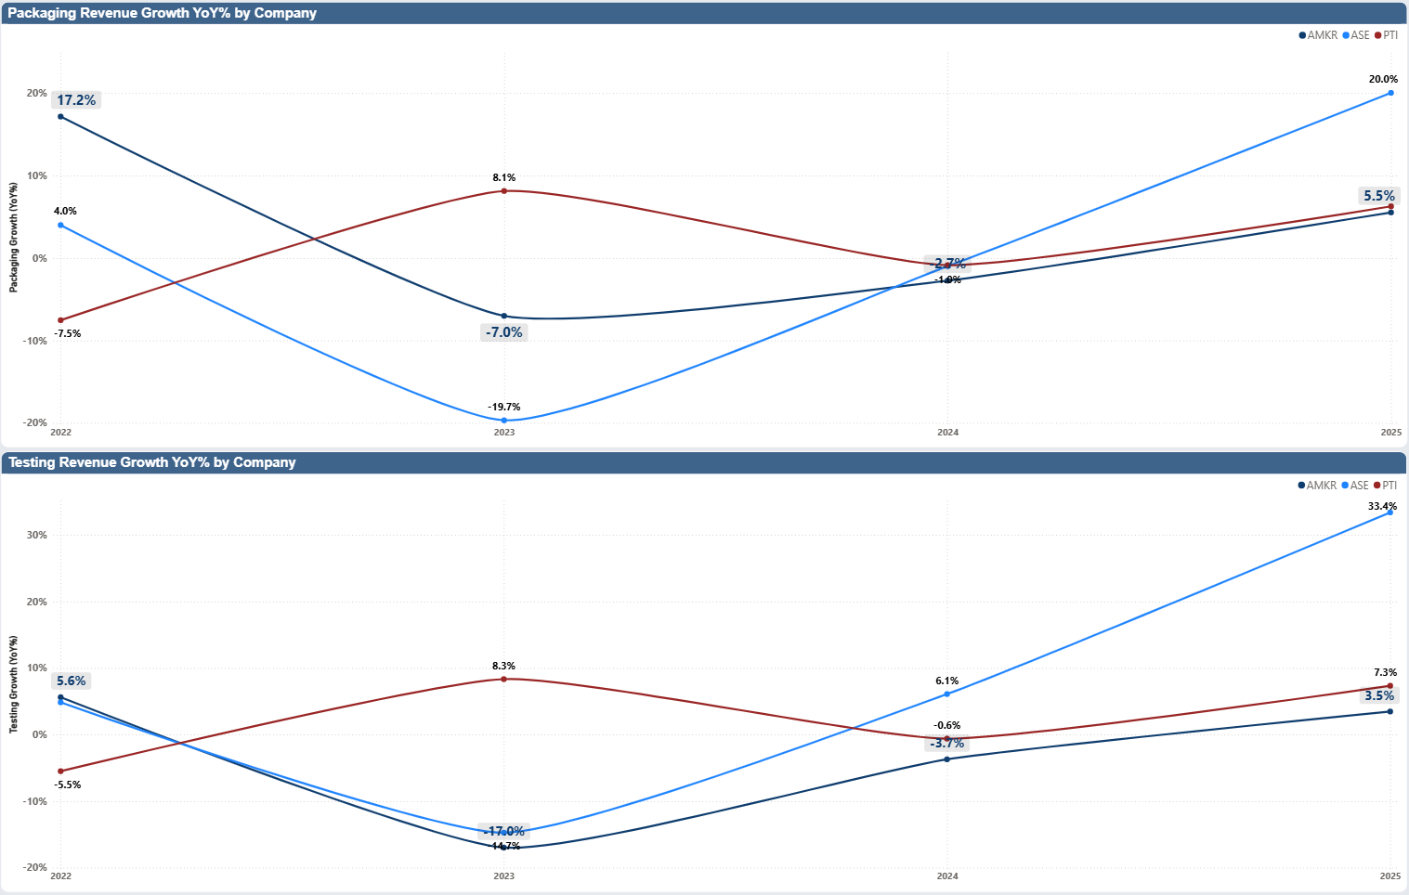
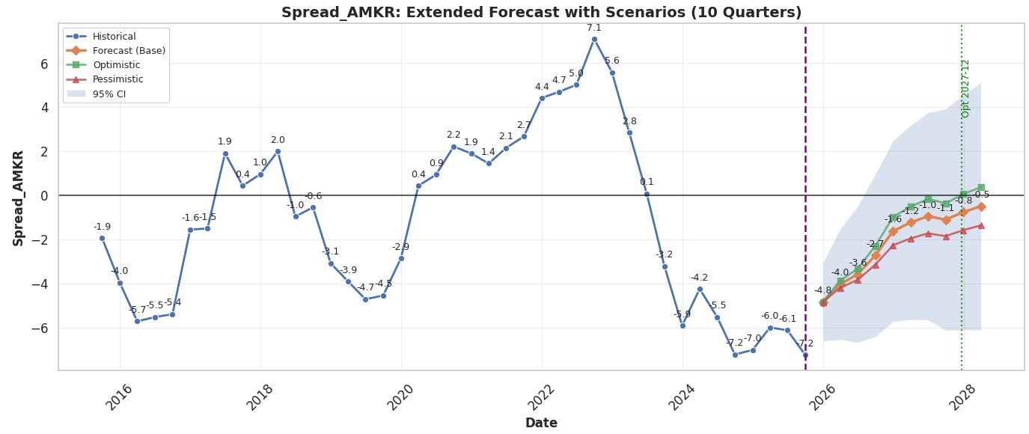
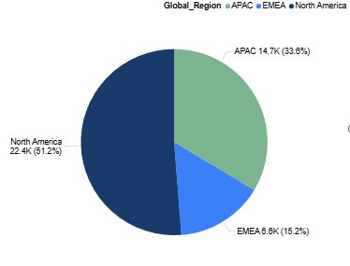
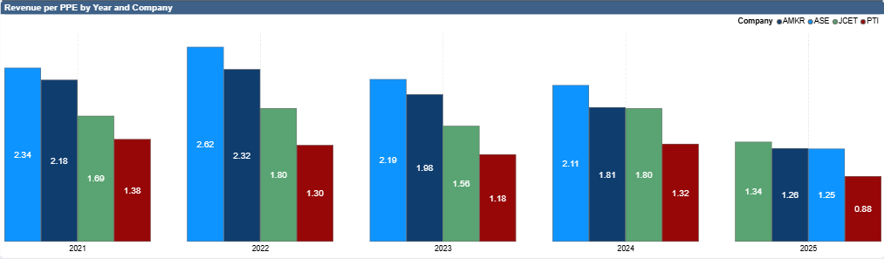
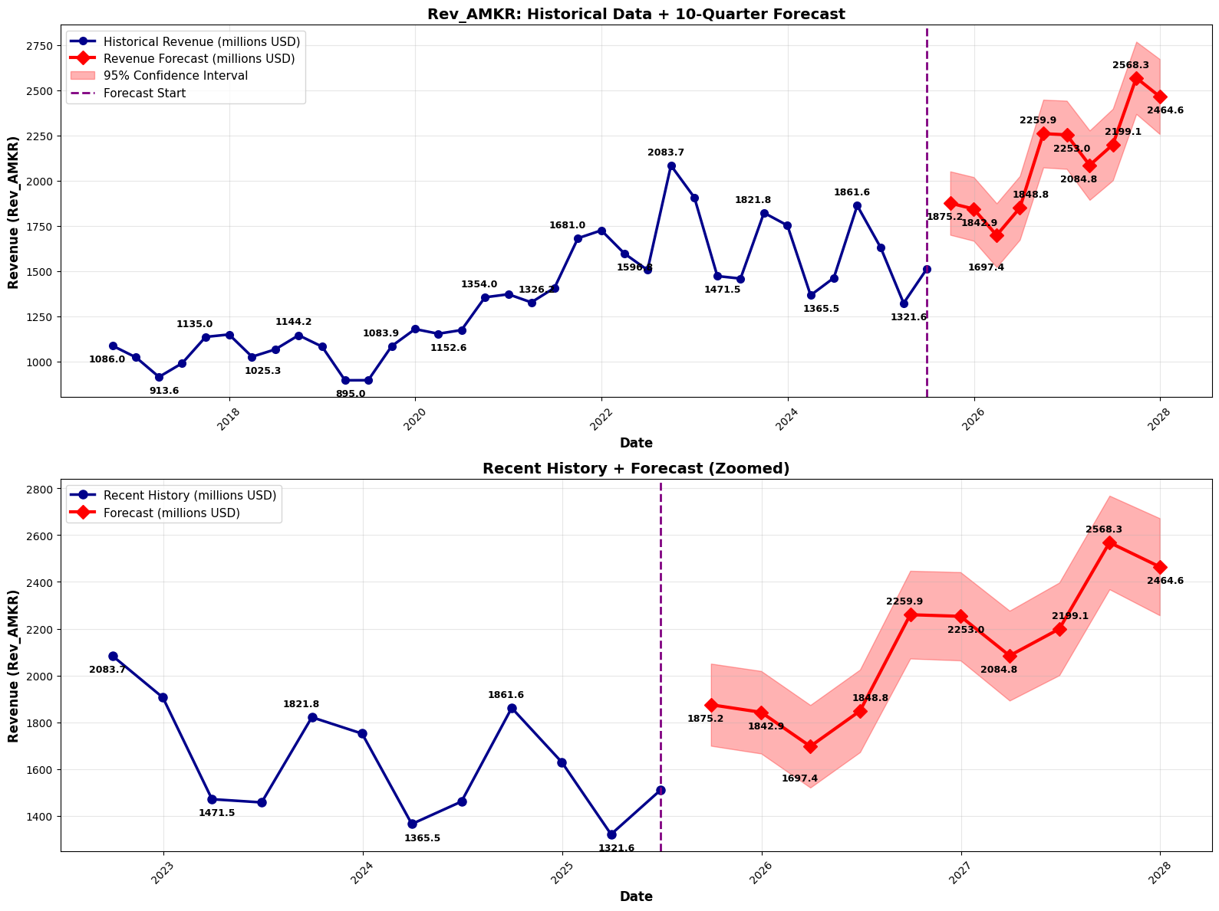

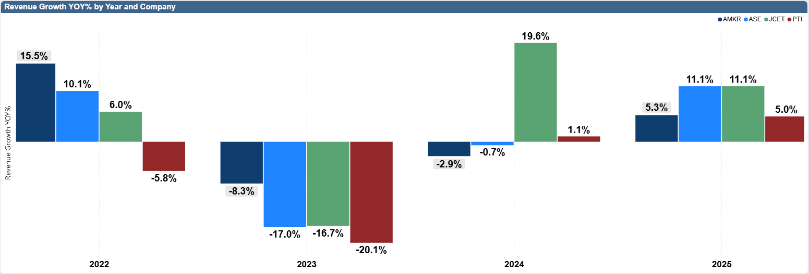
Arizona State University, W. P. Carey School of Business
Amkor Technology Interactive Financial Dashboard
Group 21: Edselmo Biondi, Kuen-Yu Yen, Piyush Gautam, Nikita N. Pawar, Ayush Kaurav
PROJECT BACKGROUND
FINANCIALS
FORECASTING MODELS
The Challenge
Amkor Technology's decision-makers lack real-time visibility into customer, vendor, and competitor performance. Critical metrics are scattered across SEC filings, press releases, and analyst reports, making manual data collection time-consuming and reactive.
Our Solution
An interactive Power BI dashboard consolidating key customer metrics with AI-powered predictive analytics to deliver actionable business insights.
Key Objectives
Real-time data visualization for better decisions
Predictive analytics to anticipate trends
AI-generated automated insights
Enhanced visibility into customers, vendors, and
competitors
ROIC–WACC Spread Forecast (10 Quarters)
All scenarios show a gradual recovery from negative spreads (ROIC < WACC → value destruction).
The optimistic scenario is the only path that turns positive, crossing above zero around 2027 Q4.
The base and pessimistic scenarios remain below zero, signaling ongoing pressure on value creation.
Packaging Revenue Growth:
Strong 2025 recovery - AMKR leads with 20.0% growth vs ASE (6.3%) and PTI (5.5%)
2023 downturn - AMKR hit lowest at -18.7%, worse than competitors
Most volatile - largest swings from -18.7% to +20.0%
2022 start weak - only 4.0% vs PTI's 17.5%
Testing Revenue Growth:
Exceptional 2025 - AMKR surges to 33.4%, far exceeding all competitors
Deepest 2023 decline - dropped to -17.0%, underperforming peers
Highest volatility - 50+ percentage point swing from trough to peak
Outpacing market - 2025 growth 4-9x higher than ASE and PTI
Model Performance
Test MAE: 1.14
Directional Accuracy: 93%
RMSE: 1.48
Ridge*0.1+ Lasso*0.8 + Elastic*0.1+XGB*0
OPERATIONS
Ensemble Model
AMKR Second-best performer - trails only ASE across all years.
Outperforms JCET by 20-45% throughout the period.
10-15% below ASE but significantly above JCET and PTI.
65-75% higher revenue per PPE than PTI.
Most stable - minimal volatility compared to competitors.
Consistent range of 1.73-2.32, showing reliable asset productivity.
SARIMAX
Hybrid forecast
0.4*SARIMAX + 0.4*Ensemble + 0.2*cyc_adj
Revenue Forecast (10 Quarters)
Historical revenue exhibits cyclical but upward momentum, especially post-2021 expansion cycles.
The model predicts strong revenue expansion:
Starting point: $1.7B (2026)
End of horizon: $2.4–2.6B (2027–2028)
The projection reflects expectations of continued OSAT demand growth, capacity utilization recovery, and general market expansion.
AMKR underperformed in 2023–2024 (-8.3%, -2.9%) due to weak demand in its core markets, slower adoption of advanced packaging, and intensifying competition from both OSAT peers and in-house foundry packaging.
AMKR’s growth returns in 2025 (5.3%) as demand stabilizes across its core customers and as the company begins increasing utilization in advanced packaging, allowing it to partially participate in the AI-driven industry rebound.
Forecast Statistics
Total Growth: 31.43% over 10 quarters
Average QoQ Growth: 3.56%
Model Performance
R²: 0.93
MAPE: 2.88%

